Slide 1


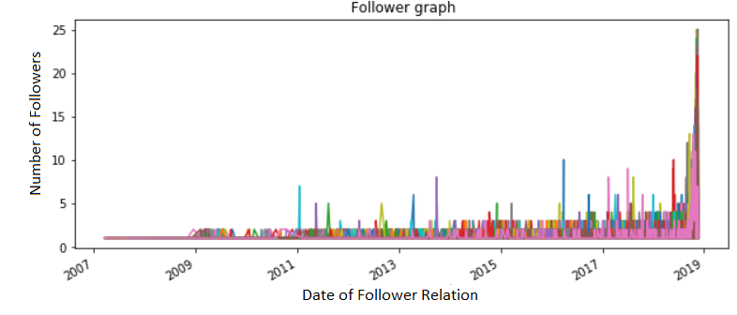
Social Network Analysis (Fall 2018)
Popularity and Connections Between Overwatch League Players
By Bruce Craig and Emersion Moniz
Introduction
Methods
Analysis and Result
Followers and friends of 47 players’ twitters from all the overwatch teams where analyzed. The data was then turned into a directed graph so further analysis could be done. Thesis going into the project where:
The graph would be connected proving links between teams
Spikes in followers would occur during games
The data in the graph determined who among the league was most popular, at what time did a player get popular and who was common among groups of fans. The graph showed teams and player communities and the links between them.
After getting all the data it was converted it into an edge list in order to make a graph. Then using that graph we where able to start to answer our questions. By looking at the predecessors of the node in question, which would be the player, a list of all the times that the follower relation was created. Using the list, data could be graphed and visualized. The times where followers spiked and tournament days could now be compared. Popularity among players was found by comparing all the in-degrees. Lastly common followers where determined by if a follower had more than 2 out-degrees because that means that they follow more than 1 player.
When the graph was made most of the theses about our data was proved. As shown in fig. 1 there are many connections between Teams and players alike. Lots of connections in the graph are between other followers of one player and another player. The fact that the data sample was relatively small (0.01% of total data set) shows that it is high probability that the teams and players are heavily connected with common followers between them.
Figure 2 shows the spike in followers over time for each player(each colored line) When looking at the graph and the graphs of independent players and compare them to game times, it is shown that the spikes match. So a player follower count increases on the days he plays in official broadcasted games.
Objective
Analyze data collected from twitter to be able to determine popularities and commonalties between teams of players from the overwatch league.
Data Collection and Processing
Tools used to collect data were, twitters API, a twitter developer account, and a python library called Tweepy. Using a custom method made, follower data was grabbed and put it in the format of
From(Follower) To(Player) Time Created(Time relation was made)
The same was done with friends but with a slight change in format
From(Player) To(Friend) Time Created(Time relation was made)
The data was cleaned and pulled it at the same time. Since pulling all the followers and friends were realistically impossible, the highest minimum of each account for followers and friends was used. In this process dead accounts that don’t add any helpful data to our set where taken out.
Fig.2 Follower Overtime Chart
Most popular player by team:
Boston Uprising: STRIKER_OW Dallas Fuel: DF_aKm Florida Mayhem: HAGOPEUN_OW Outlaws: LiNkzrOW London Spitfire: Birdring LA Glad: Hydration LA Val: Fate_ow New York Excel: saebyeolbe PHILADELPHIA FUSION: snillo_ow SAN FRANCISCO SHOCK: smurf_ow ** Most Popular
Fig. 1 Amount of common followers is 7976
References: Fujita, Tomoya. “Python Tweepy.Cursor() Examples.” What Is Servlet Container?, 2016, www.programcreek.com/python/example/76301/tweepy.Cursor.

